Slide 1


Traffic Violations in us: Predicting Property damage due to traffic violations
Members :
Bandaru Krishna Kanth
Sudarsan
Vijay Viswanathan
Sandeep
Madhumitha Raghuraman
Mentor :
Jaitender Bedi

Slide 2
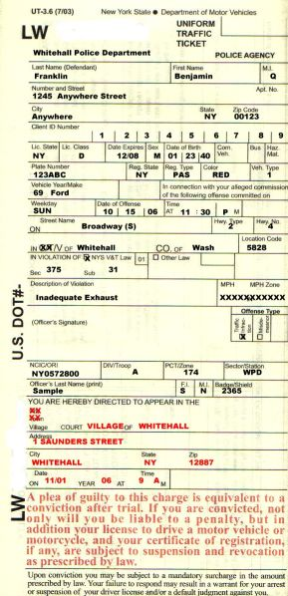
INTRODUCTION
Generally, In the United States federal criminal code, crimes are divided into two broad categories: Misdemeanors and Felonies.
Misdemeanors are crimes that carry a maximum of one year of jail time.
Felonies are crimes with punishments in excess of one year of imprisonment.
A traffic ticket is a notice issued by a law enforcement official to a motorist or other road user, indicating that the user has violated traffic laws.
Traffic tickets generally come in two forms, moving violation, such as exceeding the speed limit, or a non-moving violation, such as a parking violation, with the ticket also being referred to as a parking citation, or parking ticket.

Slide 3



MISDEMEANORS & FELONY TRAFFIC VIOLATIONS
Misdemeanor traffic violations are punishable by fines and/or jail time of less than one year.
Such violations may include:
Driving under the influence of drugs or alcohol
Driving without a valid driver’s license
Driving without insurance (in some states)
Failing to stop at the scene of an accident
Reckless driving that potentially endangers others
Traffic offenses that result in felony criminal charges usual involve severe injuries or serious property damage. A large number of felony traffic violations are the result of DUI-related incidents. Traffic violations that commonly result in felony charges include:
Hit-and-run accidents
Repeat DUI convictions
Vehicular homicide
Repeat traffic offenses such as driving without a valid license

Slide 4
US CHARGES ON PROPERTY DAMAGE
U.S.C Section 1361
DESTRUCTION OF GOVERNMENT PROPERTY
Misdemeanors Violations
When property damage does not exceed $100, the offense is a misdemeanor punishable by a fine of up to $100,000, one year imprisonment, or both.
Felonies Violations
if the damage exceeds $100, the defendant is subject to a fine of up to $250,000, ten years imprisonment, or both

Slide 5


PROBLEM STATEMENT
Law Enforcement Department wanted to know about factors which leads to property damage.
Model Prediction:
To predict whether Property Damage occurred or not due to traffic violation.
Objectives:
To find the influential parameters for property damage.
To research and visualize the property damage based on factors.
To analyze the reason behind property damage and therefore to reduce the public property loss.

Slide 6
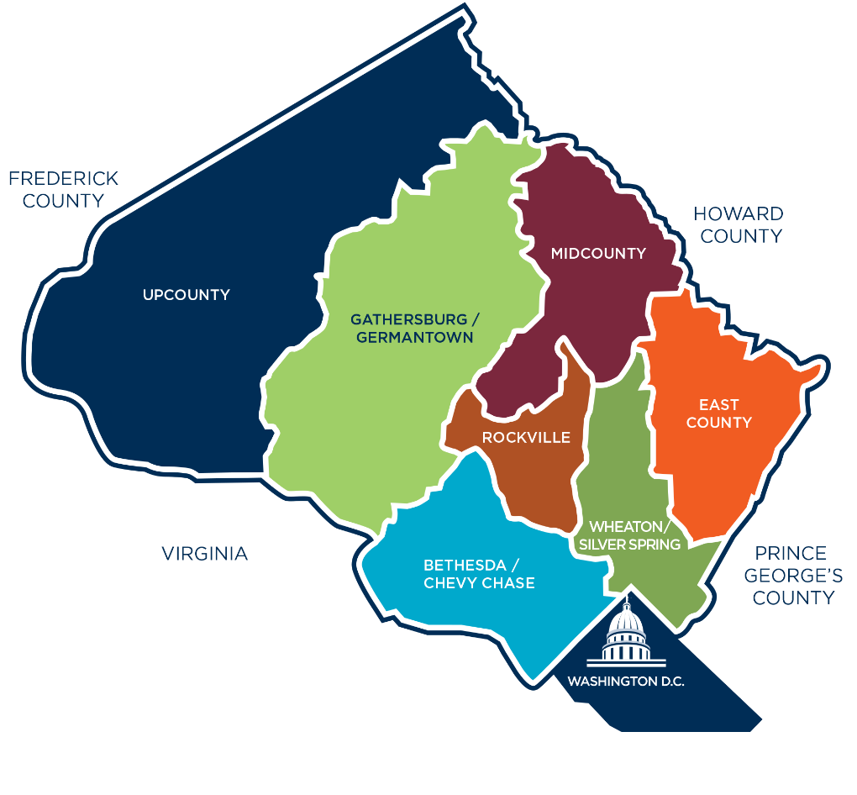
DATASET OVERVIEW
DATASET DESCRIPTION
The dataset has 15,80,153 records versus 35 features
The dataset consists of 2 numerical, 2 ordinal and 31 categorical attributes.
DATASET SOURCE
Montgomery County is the most populous county in the U.S. state of Maryland, located adjacent to Washington, D.C.
https://data.montgomerycountymd.gov/api/views/4mseku6q/rows.csv?accessType=DOWNLOAD

Slide 7
PROCESS FLOW
Descriptive Analytics
Problem Definition
Understading the data
Sampling and Statistical verification
EDA
Observations and Insights
2) Predictive Analytics
Problem Approach
Model Building
Testing and Validation
Model Improvement
Model Selection

Slide 8

UNDERSTANDING THE DATA

Slide 9
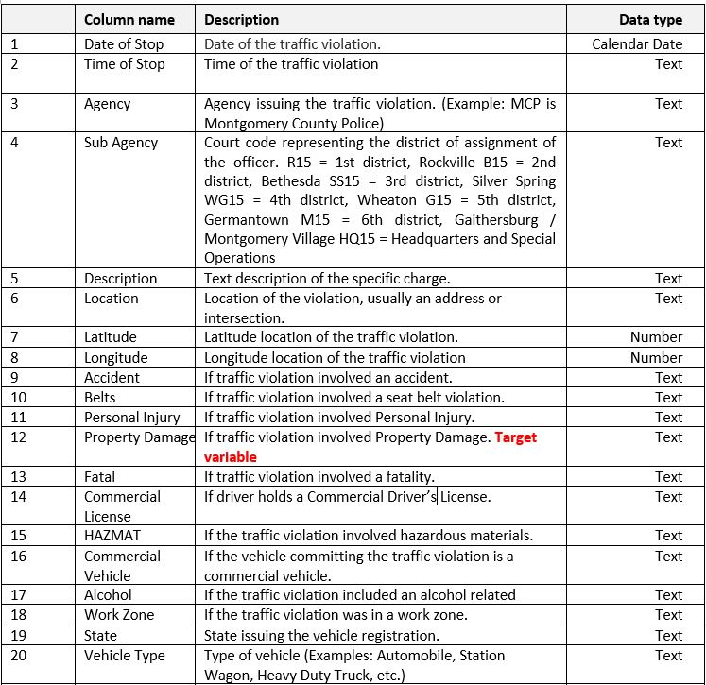
FEATURES DESCRIPTION
Total number of features : 35
Time of violation
Agency involved in recording violations
Location details – where violations occurred
Violation details (causes and effects of the violation)
Possible target variables:
‘Accident’ – are some violations less severe than others? ✗
‘Fatal’ – What kind of violation cases result in fatality? ✓
‘Property damage’ – What kind of violation cases would result in property damage? ✓
Target variable chosen: ‘Property damage’
TABLE 1- Features Description Table

Slide 10
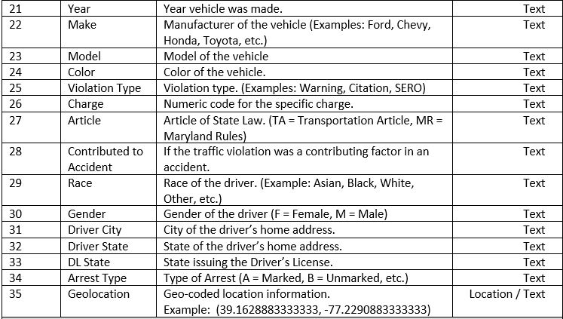
FEATURES DESCRIPTION
Total number of features : 35
Vehicle Details
Violation Record details
Driver details
TABLE 1- Features Description Table

Slide 11
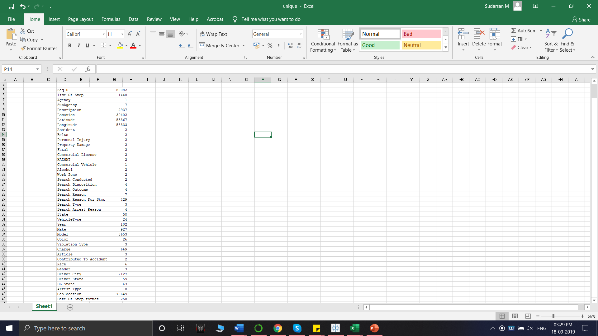
UNIQUE VALUES IN FEATURES
Unique ID for each record
Same for all records
Same for all records
TABLE 2- Unique Values in features

Slide 12
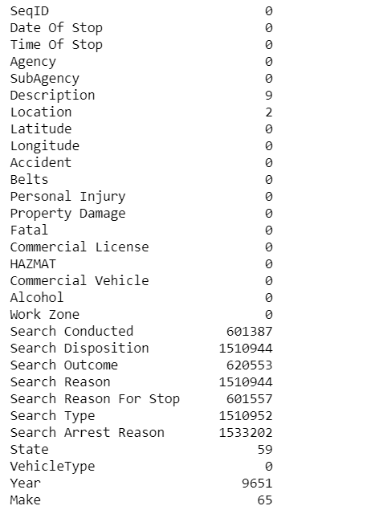
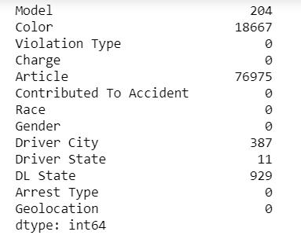
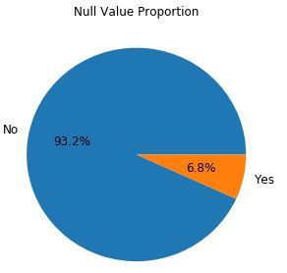
NULL VALUES STATISTICS
TABLE 3- Null Value Statistics
We have null values in 18 features
< 7 % records with null values
We can drop such records without much data loss

Slide 13
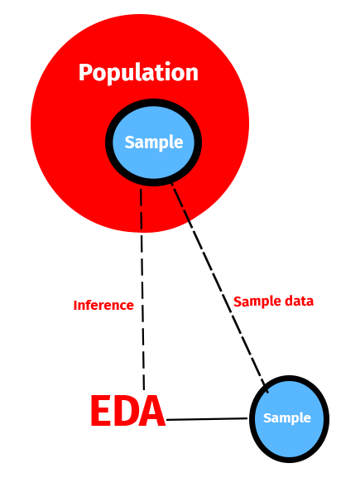
DATA SAMPLING
Since, we have 15,80,153 records in population, it is difficult to handle dataset.
In population, Dataset contains records from 2012 to 2019.
We used Simple Random Sampling technique for sampling.
This is a statistical technique where every record has an equal probability to be selected.
We split the dataset into year-wise records, and sampled 10% data records from each year-wise dataset
Since violations that involved property damage was far les compared to those that didn’t, SMOTE technique (Synthetic Minority Oversampling Technique) was used to balance the dataset.
Now, the Sample dataset had 158016 records with 43 features, with 50% property damage data.

Slide 14
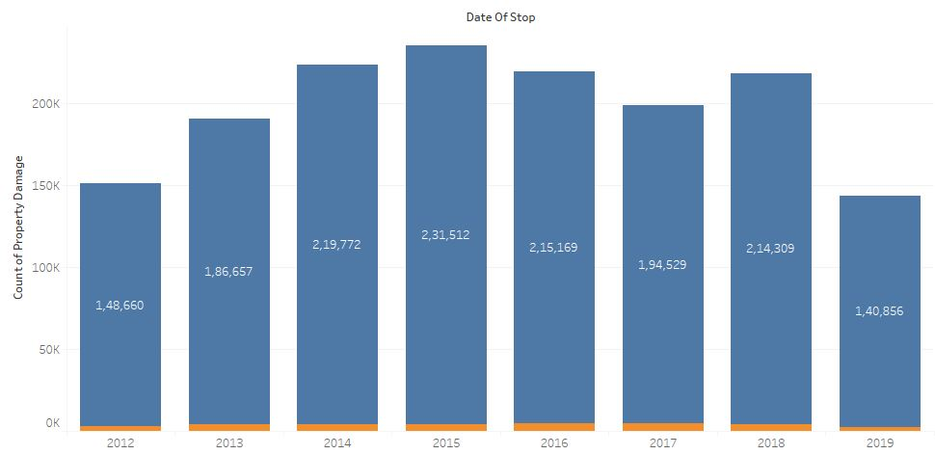
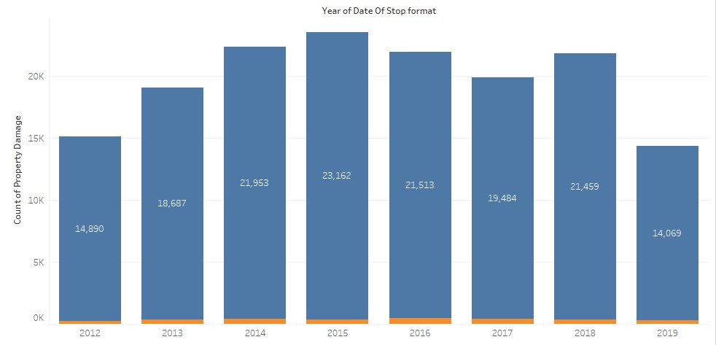
STATISTICAL TESTING
Since random sampling was done, Two tailed Test of proportion was done for major attributes at 95% confidence level
Null Hypothesis: Proportions are equal in sample and population.
P value = 0.99 ; Null hypothesis rejected
Sample dataset can be used for modelling
Target variable distribution in Population
Target variable distribution in Sample

Slide 15


Slide 16
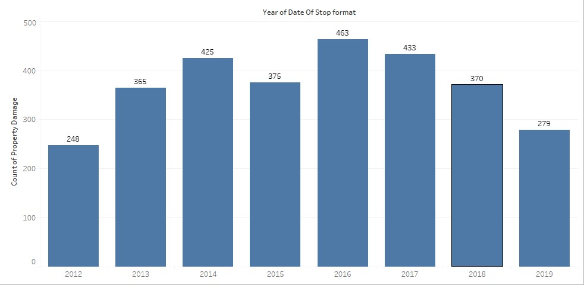
YEAR VS PROPERTY DAMAGE
Observations:
The number of vehicle miles traveled on U.S. roads in 2016 increased by 2.2 percent.
Insight:
NHTSA found that distracted driving and drowsy driving fatalities declined, while deaths related to other reckless behaviors – including speeding, alcohol impairment, and not wearing seat belts – continued to increase.

Slide 17
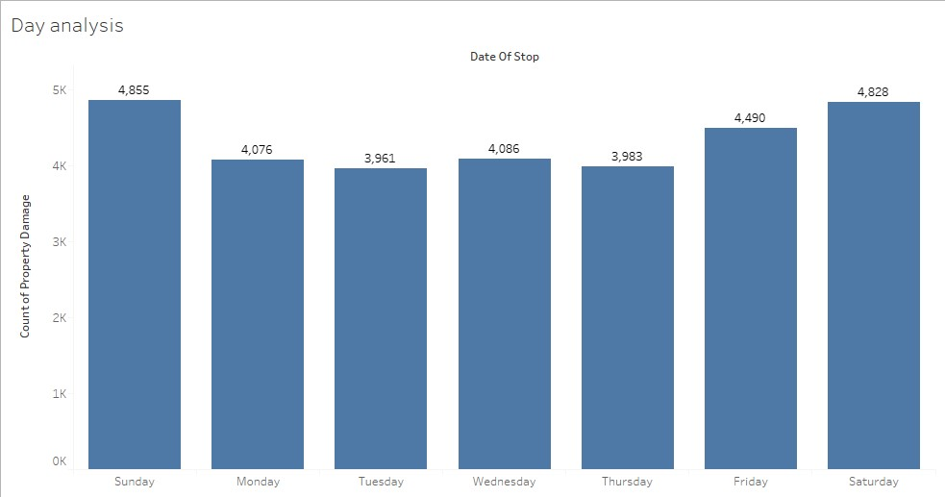
DAY OF THE WEEK VS PROPERTY DAMAGE
Observations:
We can see more property damage happen in Friday, Saturday and Sunday.
Insight:
It is because people generally like to spend their weekends outside and hence more vehicles are on road than weekdays

Slide 18
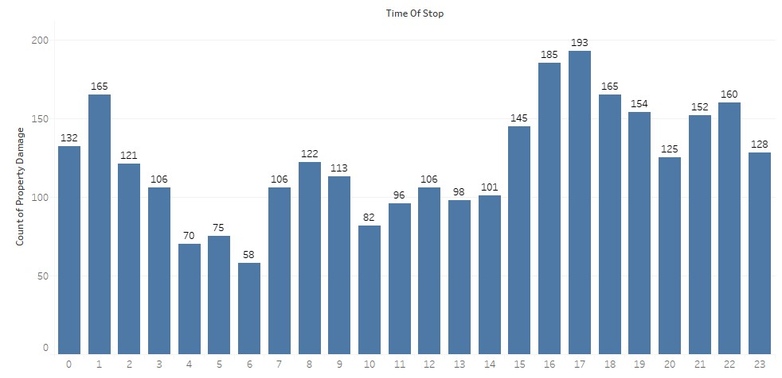
TIME OF DAY VS PROPERTY DAMAGE
Observations:
we can see total number of accidents peaking around 3,4,5 PM and again at 1 AM
Insight:
Most offices in Maryland follow 9-5 job timings and hence the vehicle density during that time is high which increases the chances of accident

Slide 19
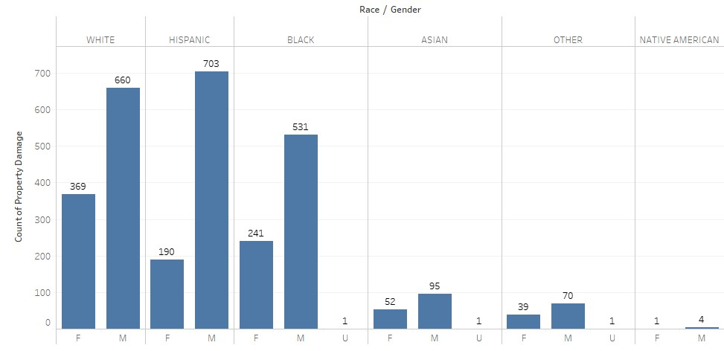
RACE AND GENDER VS PROPERTY DAMAGE
Observations:
White, Hispanic and Black race Whites race account for 90% of accidents with property damage. Considering that Blacks race and Hispanics constitute only 29.72% and 3.22% of the population, their contribution to accidents is very high.

Slide 20
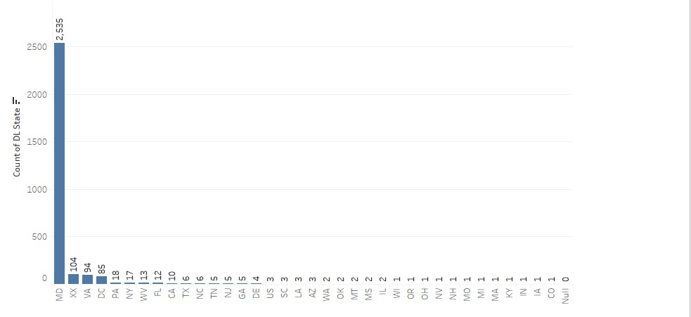
OFFENDER’S STATE
Observations:
Peoples who belong to their own state (Montgomery County) commit more accidents than the outsiders

Slide 21
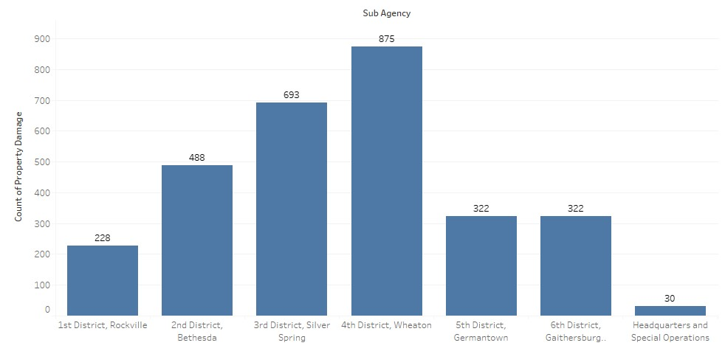
DISTRICT WISE PROPERTY DAMAGE
Observations:
We can see more property damage happen in Friday, Saturday and Sunday.
Insight:
It is because people generally like to spend their weekends outside and hence more vehicles are on road than weekdays

Slide 22
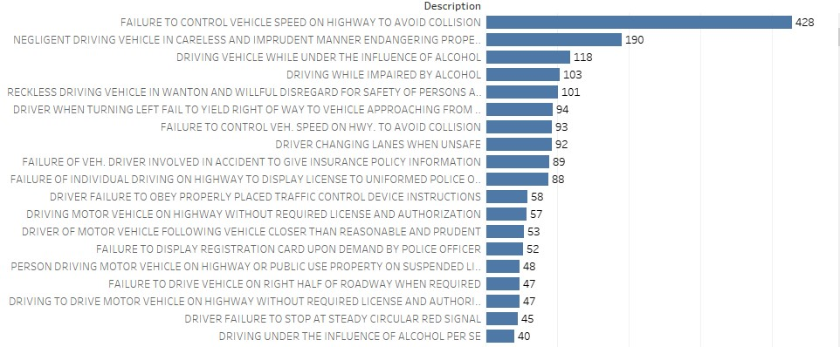
REASON FOR ACCIDENTS

Slide 23
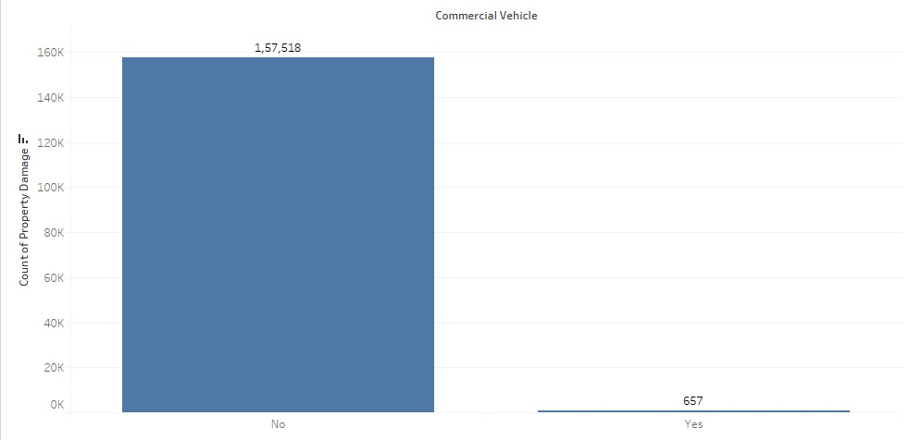
COMMERCIAL VEHICLES VS PROPERTY DAMAGE

Slide 24
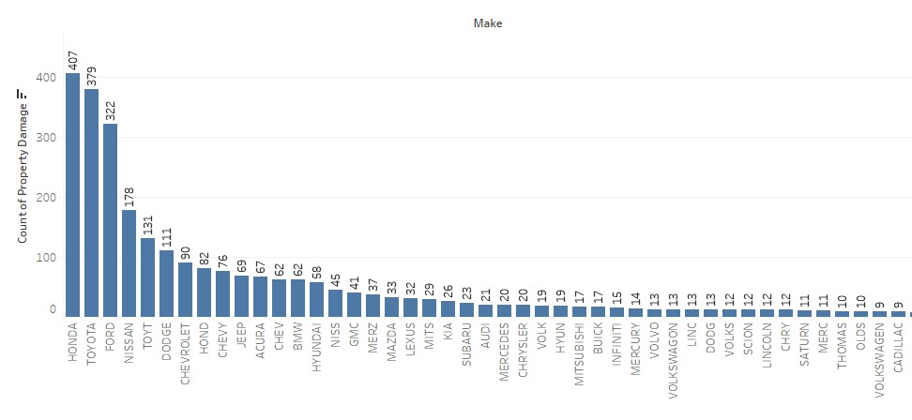
VEHICLE MAKE VS PROPERTY DAMAGE
Observations:
Toyota(9489), Honda(8915), Nissan(6239) and Ford form the bulk of usage in USA. Due to sheer high number the property damage instances too are higher.

Slide 25
DISTRICT WISE PROPERTY DAMAGE

Slide 26
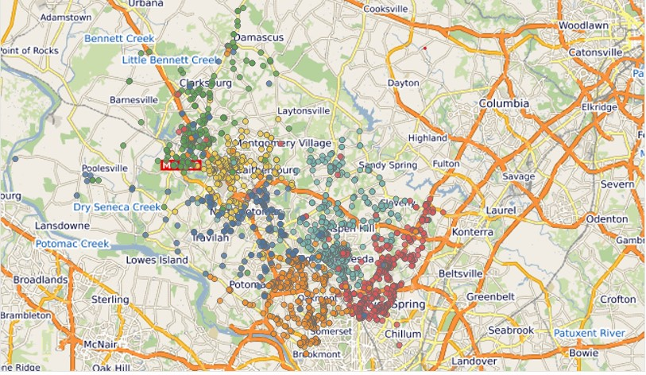
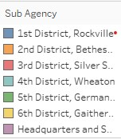
ACCIDENT CLUSTERS

Slide 27
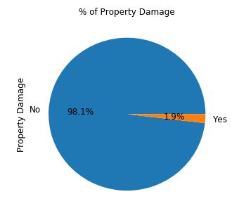
IMBALANCED DATASET
Target Variable Count:
Shape of X and Y variables
Shape of X: 158175,21
Shape of Y: 158175,1
Target Variable Class Count:
Before SMOTE:
Count of Label 1: 2958
Count of Label 0: 155217
After SMOTE:
Count of Label 1: 155217
Count of Label 0: 155217

Slide 28
MODEL BUILDING
We used three Machine Learning Models to predict the property damage class.
Logistic Regression
Decision Tree Classifier
Random Forest
We are considering Logistic Regression as a Base Model

Slide 29
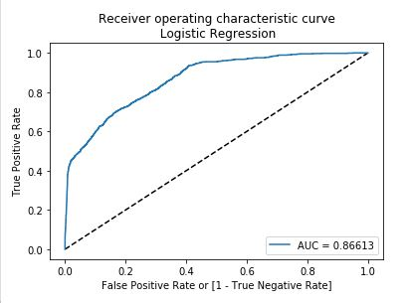
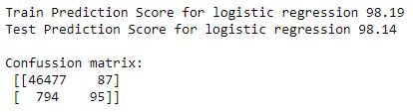

LOGISTIC REGRESSION (BASE MODEL)
BEFORE SMOTE
Model Scores
Evaluation Metrics
ROC Curve for Logistic Regression

Slide 30
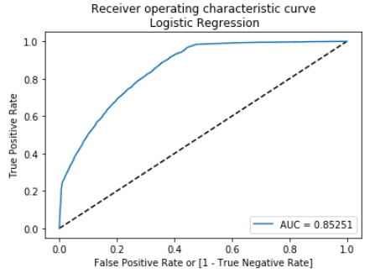



LOGISTIC REGRESSION (BASE MODEL)
AFTER SMOTE
Model Scores
Evaluation Metrics
ROC Curve for Logistic Regression

Slide 31
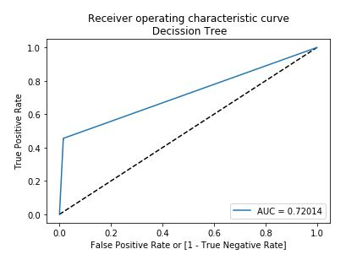
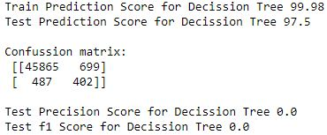
DECISION TREE CLASSIFIER
BEFORE SMOTE
Model Scores
Evaluation Metrics
ROC Curve for Decision Tree

Slide 32
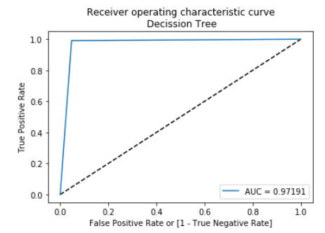
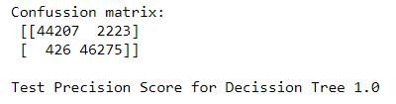
DECISION TREE CLASSIFIER
AFTER SMOTE
Model Scores
Evaluation Metrics
ROC Curve for Decision Tree

Slide 33
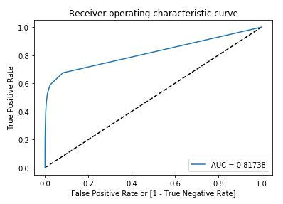
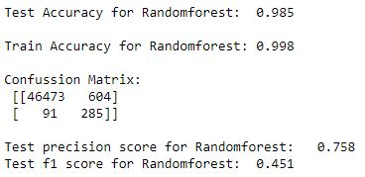
RANDOM FOREST
BEFORE SMOTE
Model Scores
Evaluation Metrics
ROC Curve for Random Forest

Slide 34
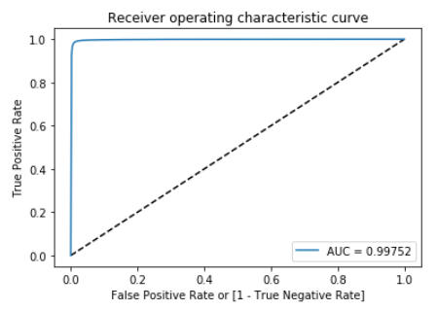

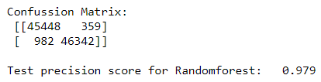
RANDOM FOREST
AFTER SMOTE
Model Scores
Evaluation Metrics
ROC Curve for Random Forest

Slide 35
COMPARING MODEL SCORES
Logistic Regression | Decision Tree Classifier | Random Forest
Train Prediction Score 76.42 | Train Prediction Score 99.95 | Train Prediction Score 98.6
Test Prediction Score 76.42 | Test Prediction Score 97.16 | Test Prediction Score 99.9
[29174 17256] [ 4742 41959] | [44207 2223] [ 426 46275] | [45448 359] [ 982 46342]
AUC: 0.853 | AUC: 0.972 | AUC: 0.998
F1 SCORE: 0.79 | F1 SCORE: 1.0 | F1 SCORE: 0.451

Slide 36
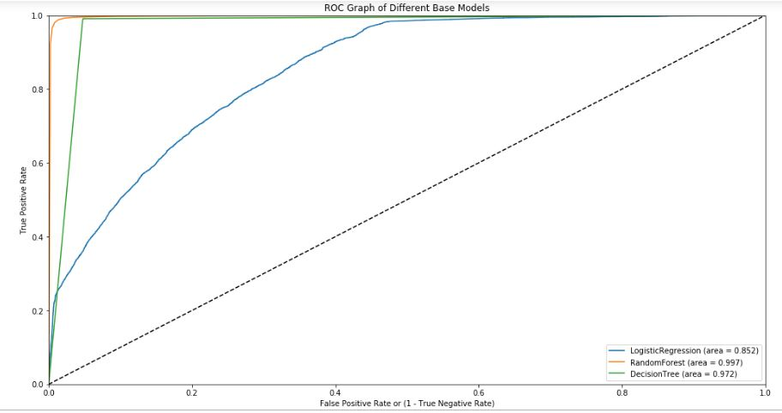
ROC CURVE COMPARISON OF THREE MODELS

Slide 37
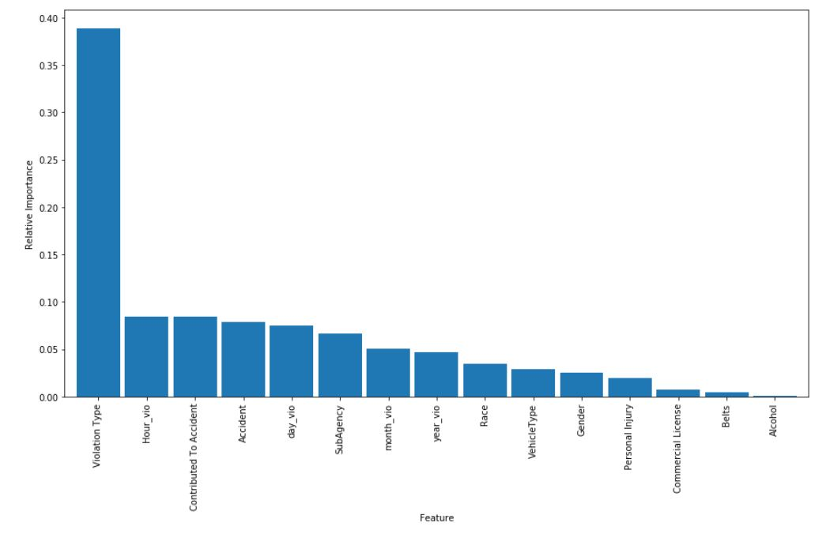
FEATURE IMPORTANCE BY RANDOM FOREST
Influential Features:
Sub Agency
Race and gender
Time of day
Day of the week
Location

Slide 38

CONCLUSION
Based on the business use case, the independent variable was selected to be ‘Property damage’. The objective was to predict the vulnerability of a vehicle to property damage, using features like Geographical info, Season, features of the Car.
Data Sampling was done and sample and population characteristics were statistically tested.
EDA on the dataset gave us insights on the probable factors that contribute to property damage.
Classification models were built using Logistic Regression, Decision Tree Classifier and Random Forest.
Through model evaluation Random Forest Classifier was selected.

Slide 39
RECOMMENDATIONS
The project is aimed at assisting Law Enforcement Department in Montgomery County to know about factors which leads to property damage during traffic violations.
Based on the insights from EDA, accidents prone to damages have a pattern with respect to time, geography and driving errors. The traffic control team could focus on mitigating these factors through road safety planning and enforcing regulations.
The results from the model prediction can be used as a litmus test during Used Car Inspection for resale. If the model predicts that the vehicle could have been susceptible to property damages, stringent inspection can be done to ensure the vehicle condition.

Slide 40

LIMITATIONS
‘Accident’ is a chance occurrence, and this project aims at predicting the outcome of such an occurrence with known factors. Hence, the output of this model cannot be taken as a standalone solution. Rather it gives a caution on various risk factors.
We believe that with more features, especially real time traffic information, construction work details, important events, weather conditions, etc. we can improve this model significantly for real time use cases.

